Slide 1

Slide A
Navigation
As a Class
What structures did the materials seem to have in common that were good at reducing peak forces?
Notes:
Revisit a previous question from the end of the last lesson. Show slide A. Discuss the question as a class.
Continue the discussion around how this type of structure can help reduce peak forces in a collision. Example prompts and responses are located in the teacher guide.
Say, OK, so we know that there are certain structures in common with the materials that reduced peak forces the best, like air or space between the walls, and we think this might have something to do with why they reduce peak forces in a collision even when the kinetic energy of the objects before the collision doesn’t change. But how is it possible that these materials are actually causing the strength of the maximum peak force between the objects in a collision to go down? Let’s try and develop a model for what might be happening within the structures that make up those materials that can help us figure out how this is possible.

Slide 2
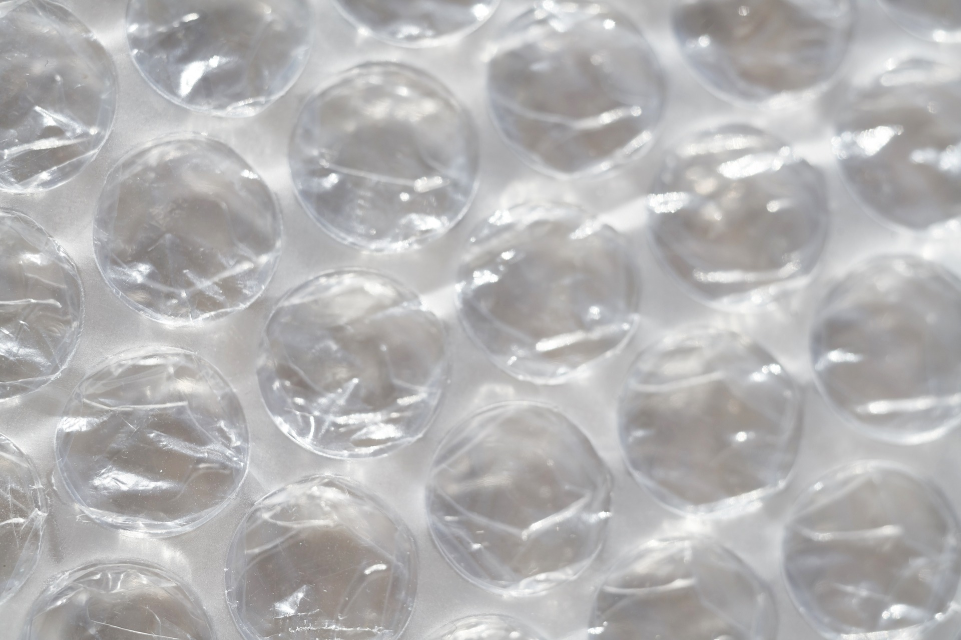
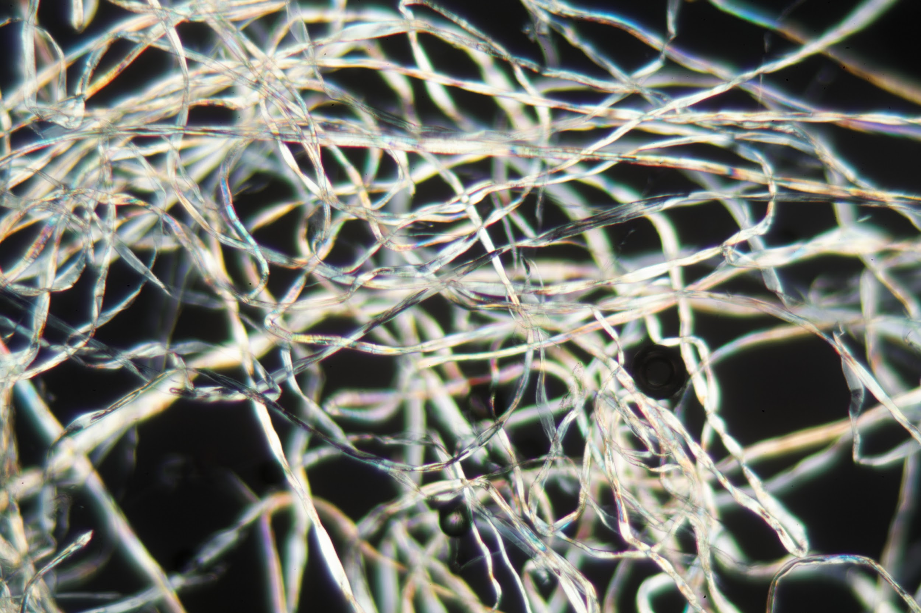
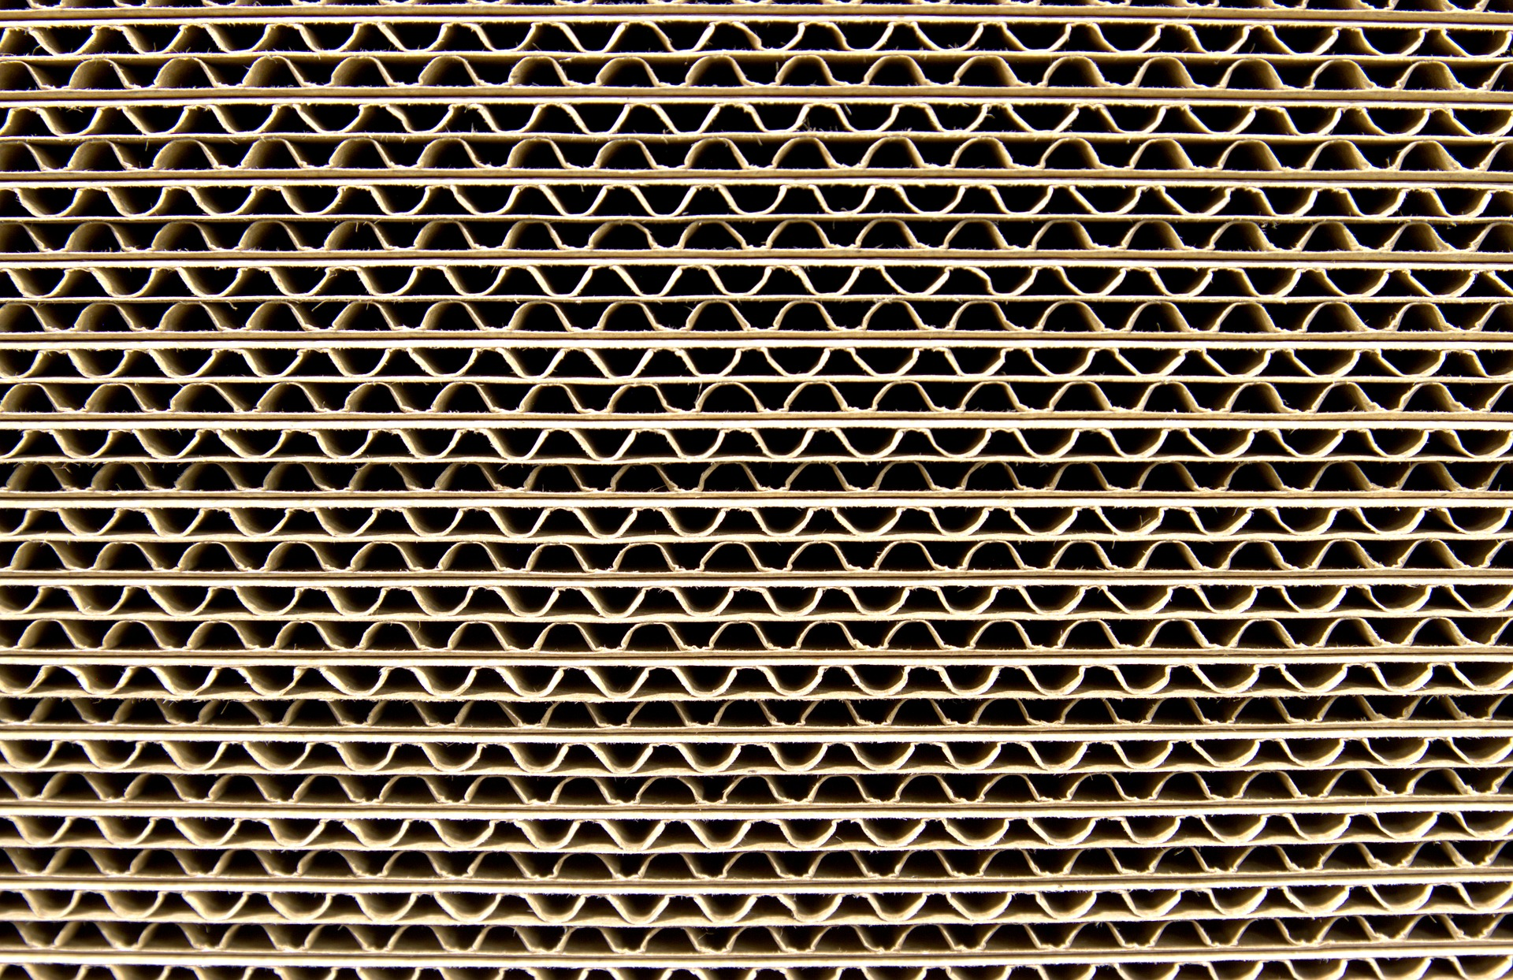
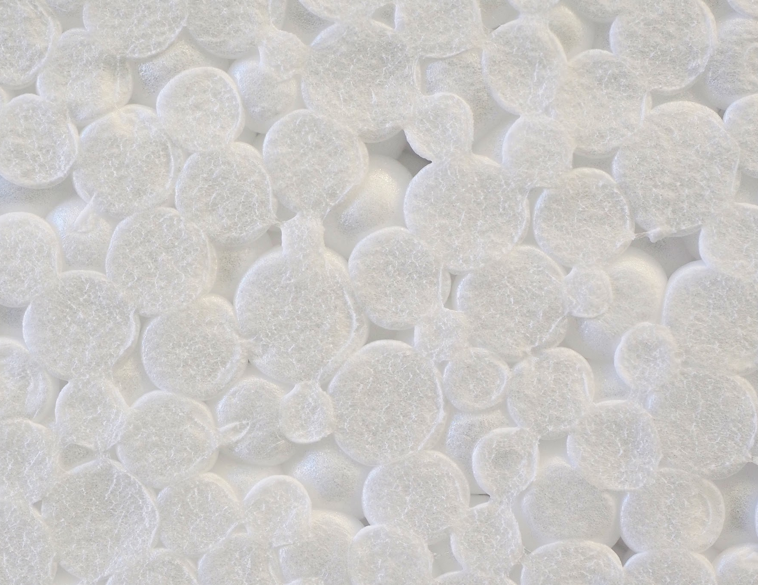
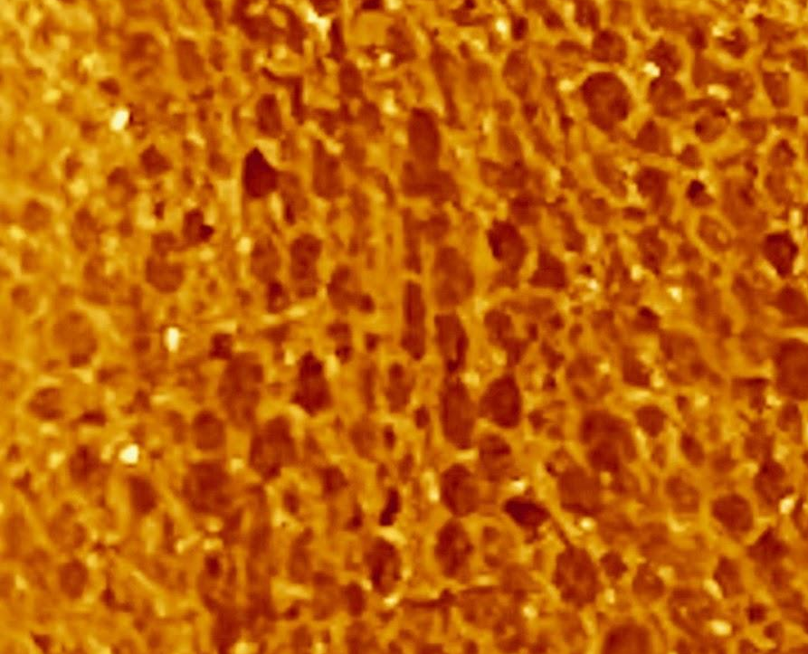
Predicted Material Performance
Slide B
Bubble wrap up close
weisschr
Cotton ball up close
Corrugated cardboard up close
Styrofoam up close
Foam earplug up close
Notes:
Meet in a Scientists Circle for a Building Understandings Discussion. Show slide B. Introduce the need for a model to represent similarities in the small and microscopic structures. Say, Let’s try to draw a representation of the sort of general structures we all agree are a part of these materials at a small or microscopic level that are responsible for why they behave in similar ways.
Hang the Smaller-Scale Material Structures poster on the wall where students can see it.
Ask students to describe what the structure of each of the top 4 force-reducing materials looked like when we examined a cross-section of each material. It is expected that the top performers will be Styrofoam, bubble wrap, foam ear plugs, and cotton balls. But suggested prompts and responses are located in the teacher guide for other possibilities too.
For each description that students share, draw a diagram on a half sheet of paper and tape it in the row for that material (or share a pre-drawn one). Do the same for each written description. You could ask student volunteers to be ready to help write a verbal description of what you drew for a particular row to help speed up the construction of the chart.
Again, it is expected that the top performers will be Styrofoam, bubble wrap, foam ear plugs, and cotton balls. Limit the entries you add to this poster to the top 4 force-reducing materials for your class.
Develop a scaled-up physical representation of a common structural element. Say, OK, Let’s make a scaled-up representation of some of these structures. Here is a strip of plastic material from a folder cover, if I bend it into a circle and tape it, which parts of which materials on our chart would this best represent? Which is it kind of close to representing?
Demonstrate this with a piece of a strip of 1 inch wide and 9.25 inches long cut from plastic folder cover.
Students will say it best represents a small piece of the small or microscopic structure of the bubble wrap or the foam earplugs because there are circular gaps of air or space. Alternatively, or in addition, they may say it is close to the structure of another one of the materials.
Ask students what about the structure you made represents an important aspect of the other materials, such as corrugated cardboard or Styrofoam (depending on which of these is one of your top 4 performers). Students will say that the structure you made forms a space that makes a semi-closed pocket of air or gap or space surrounded by solid material or walls, and many of the materials have a semi-closed pocket of air or gap or space surrounded by solid material.
Emphasize that even though this physical model doesn’t represent the structure of the cotton fibers as well, it still includes one key feature, namely, it has a lot of empty space in it in proportion to the amount of solid matter.
Now take a second piece of paper and tape it into a circle and then tape both circles together. Ask students which materials have a repeating pattern in their microscopic structure like the one we just built, even if the exact shape and size of the air pockets in the structure might be slightly different. Students will say it represents most of the materials, except maybe for the cotton ballor Styrofoam. In the case of the Styrofoam students may say that the ratio of solid material to air or empty space isn’t right and that to represent Styrofoam, we need more solid and less air between the repeating structures.
Say, We’ve made an argument here that this larger-scale structure represents something important we are seeing in the small and microscopic structures of many of these top force-reduction materials. They all have a large amount of air or space gaps in between the solid matter, just like this structure does. Now that we have analyzed a large-scale physical model that represents this important aspect of the structure of peak force reducers, we could use it to understand what might be happening at a much smaller scale within those small and microscopic structures of our top force-reducing materials. This is something that engineers and scientists often do when they want to understand how something works at a scale that is too small to see. They develop larger-scale models and test how those work and use the results of these tests to better understand the unobservable changes occurring in those smaller structures.

Slide 3

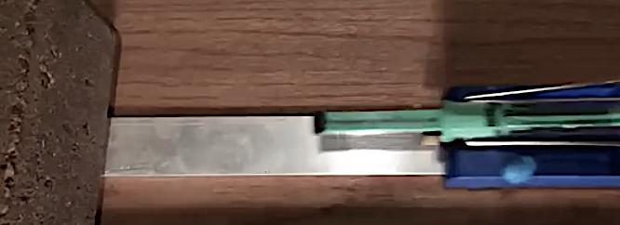
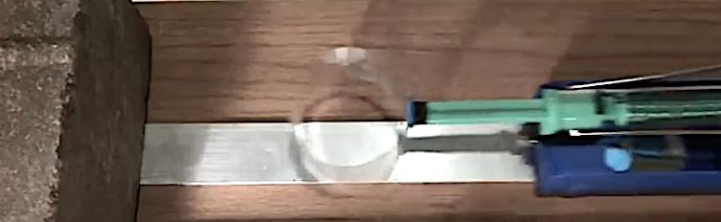
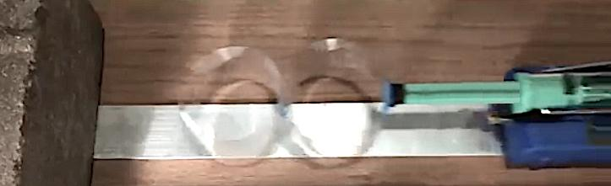
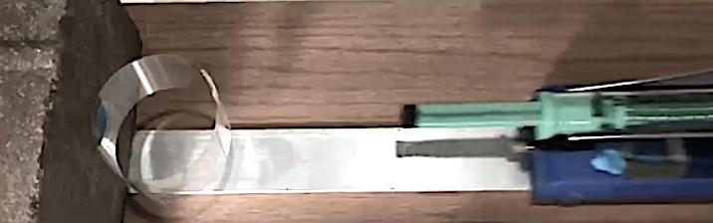
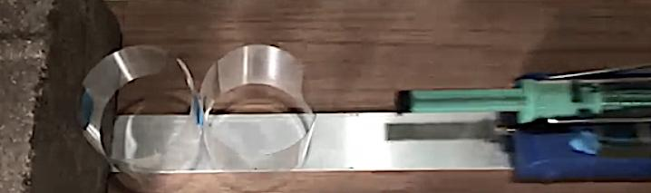
Predicted Material Performance
Slide C
Turn and Talk
Would adding ring structures to the system, as shown to the right affect the peak forces in the collision? Why or why not?
Would attaching this sort of structure to the stationary object (brick), instead of the end of the spring scale affect the peak forces in a collision? Why or why not?
Notes:
Show slide C. Use this to cue students to turn and talk about the following questions:
Would adding ring structures to the system, as shown in B and C, affect the peak forces in the collision? Why or why not?
Would attaching these structures to the stationary object (brick), as shown in D and E, instead of to the moving object affect the peak forces in a collision? Why or why not?
Listen for different predictions in the partner talk.
Prepare to record data. Pull students together. Share that you heard different predictions in the partner discussions and suggest that we should try to collect some observations to see which of these predictions are supported or refuted.
Distribute a half-sheet data table from Observations from Adding Additional Ring Structures to each student and have them add it to their notebook.

Slide 4
Slide D
Record and Analyze Data from Slow-Motion Videos
As a Class
Watch videos A and B and record your observations.
Discuss what you notice from these.
View videos A and B again and record any additional observations.
View videos C, D, and E and record your observations.
Video links
Video A
Video B
Video C
Video D
Video E
Notes:
Show slide D. Say, Let’s start by watching the first two conditions outlined in our data table.
Show video A: https://youtu.be/co5fN22N50A. Give students a minute to record their observations.
Show video B:https://youtu.be/OU0LsRFmBnk. Give students a minute to record their observations.
Before showing any other videos, discuss what students noticed to motivate watching these first two videos a second time with the goal of recording data that would allow us to determine the total length of collision time in each condition. Example prompts and responses can be found in the teacher guide.
Say, Let’s watch these two videos again and record additional observations regarding the amount of time the collision took. You decide if you want to record how long it took to reach peak force after first contact occurred or if you want to record how long it took until the contact between the objects ends. Either way you will have to record at least two times. That will allow you to calculate and compare the length of time these events took in different collision conditions.
Ask students to stand in a semi-circle around the screen you are projecting the videos on before showing the videos again. Students can ask you to pause the videos at any time so they can take a closer look. Encourage students to go up to the screen and point to things in the video when they ask you to pause it. Students are likely to ask you to pause at each of these points in time:
The point of first contact between the leading edge of the cart system and the leading edge of the brick system.
The point where the peak force is reached
The point at which contact is broken between the ring on the brick and the cart subsystem
Show videos A and B again.
video A: https://youtu.be/co5fN22N50A
video B: https://youtu.be/OU0LsRFmBnk
Then show videos C, D, and E.
video C: https://youtu.be/3A1gKY2qK1U
video D: https://youtu.be/eqKLBJFZlnE
video E: https://youtu.be/nqaDgidCHOM

Slide 5
Slide E
Analyzing and Interpreting Our Data
As a Class
What patterns did you notice in the peak forces produced?
What patterns did you notice in the time these collisions took?
Notes:
Facilitate a discussion of the patterns across the five collision cases. Have students return to their seats. Show slide E. Cue students to read through the questions on their own and study the data table for a minute independently. Then discuss the questions on the slide as a whole group.
First focus on asking students to summarize the relationships they discovered among the number of structures that have space in them to deform, the length of time the deformation is occurring over, and the peak forces produced in the collision. Example prompts and responses are located in the teacher guide.
Now shift to asking students to generalize the relationship between the strength of force applied to an object and the time it takes to change the motion of the object. Example prompts and responses are located in the teacher guide.

Slide 6



Slide F
Update Progress Tracker
On Your Own
Progress Tracker
Question
What I
figured out
Add to your Progress Tracker. Record the question we are trying to figure out: How (and why) does the structure of a cushioning material affect the peak forces produced in a collision?
Record what you figured out.
Be prepared to share with the whole class.
Notes:
Update individual Progress Tackers. Say, These ideas are all based on observing these large-scale structures. But let’s remind ourselves that these weren’t the specific structures we were interested in explaining at the start of our lesson. We were initially interested in explaining how and why the microscopic structure of an effective cushioning material decreases the peak forces in a collision. Let’s take a moment to think about how we apply what we figured out to those materials.
Show slide F. Give students the remaining time to add an entry to their individual Progress Trackers in their science notebook related to the lesson question:
How (and why) does the structure of a cushioning material affect the peak forces produced in a collision?
Ask students to leave their notebooks for you to review before the next class.

Slide 7

Slide G
Develop a Classroom Consensus Model
As a Class
Meet in a Scientists Circle and develop a series of free-body diagrams to represent what you figured out about this question:
How (and why) does the structure of a cushioning material affect the peak forces produced in a collision?
Notes:
Say, At the end of our last class you summarized what you figured out about how and why the structure of a cushioning material affects the peak forces produced in a collision. Let’s use what you figured out to think about what is happening to each structure in the system from a free-body diagram perspective and then use that form of system thinking to make predictions about what would happen when we change the structure of the materials we are using in other ways. Show slide G.
Distribute Free body diagrams for collisions with and without cushioning structures to each student and have them add it to their notebook.
Gather students in a Scientists Circle. Bring the Consensus model from Lesson 5 with the free-body diagram on it to the circle.
Ask students to compare the objects and subsystems represented for each of the conditions shown in the system diagrams on the handout and describe what is simplified in these representations. Suggested prompts and sample responses are located in the teacher guide.
Introduce another modeling convention in free-body diagrams. Say, These sorts of simplifications, leaving out some details and objects and paying attention to a subset of them in a system, are commonly done when engineers or scientists make free-body diagrams of moving objects. Many times the objects in the system are simply shown as rectangles or circles rather than including other details that don’t necessarily help visualize where the force interactions are occurring in the system.
Connect to other examples of simplified representations of objects and interactions from work students have done in prior OpenSciEd units. Say, When this sort of simplified representation is used, however, it's important to label each object in the system that you are developing a free-body diagram for. You’ve made similar simplifications for other system models you’ve developed in other units. For example, in your work on [material:ec.n] when modeling interactions in the palm oil and native ecosystems for orangutans, what are some of the populations of organisms in the ecosystem that you showed interactions between with just a simple rectangle? Students will say things like orangutans, palm oil trees, fruit trees, insects, tigers, rats, and pigs as just a few examples.
Co-develop free-body diagrams for the two subsystems in the ringless collision. Use the prompts located in the teacher guide to elicit students' ideas to add to the creation of two free-body diagrams for this condition on a piece of blank chart paper.
The completed free-body diagram should look something like the illustration in the right column shown in the teacher guide. Students should add something similar to the first row in their table on Free body diagrams for collisions with and without cushioning structures.
Co-develop free-body diagrams for the three subsystems in the single-ring collision. Use the following prompts to elicit students' ideas to create three free-body diagrams for this condition on the chart paper below the first free-body diagrams. Example prompts and responses are located in the teacher guide.
The completed free-body diagram should look something like the illustration in the right column shown in the teacher guide. Students should add something similar to the second row in their table on Free body diagrams for collisions with and without cushioning structures.
Introduce two different ways to model the two-ring condition. Say, For the two-ring condition, you could choose to represent the two rings as a single subsystem or you could represent them as two separate subsystems. In the first case you would need to show three free-body diagrams, while in the latter you would need to show four. You and your partner should decide how you want to model that condition, but remember to look back at our results from the video so that your model accurately represents the relative strength of all the peak contact forces from the interactions between each subsystem in your model.
Give students 5 minutes with an elbow partner to complete the third row in the handout. Emphasize that this is one part of a formative assessment you want to collect.
After students have completed the third row, ask if there are any questions and if students feel confident they could use this way of representing forces in each subsystem to predict what would happen if there were three rings of the same size chained together on either the spring scale or the brick.

Slide 8
Slide H
Develop and Use a Model
On Your Own
Add a diagram to the last row of your table showing the objects and subsystems that would be involved in a collision that had a series of three rings connected together on either the brick or the cart.
Create a series of free-body diagrams to show how the relative strength of the peak forces on each subsystem in this collision would compare to the other conditions.
Which collision would occur over the longest contact time? Put a star next to that row of your table and label it.
Notes:
Show slide H. Have students return to their seat to complete Free body diagrams for collisions with and without cushioning structures. Emphasize that this is the second part of the formative assessment you want to collect. Collect Free body diagrams for collisions with and without cushioning structures when students have completed their work.

Slide 9
Slide I
Predicting the Effects of Other Structural Changes
Some design solutions for protective devices may have criteria or constraints that impose a limit to the amount of space available for adding cushioning material to a system. Let’s consider a system where there is limited amount of total space available for adding cushioning material to it.
Turn and Talk
If we wanted to double the number of air gaps or spaces in the structure of a cushioning material used in the space, how would the size of those air gaps or spaces have to change in order to fit them in?
Do you think that change would also affect the reduction in peak forces those structures provided in a collision?
Be prepared to share with the whole class.
Notes:
Introduce the context for another shape consideration. Show slide I. Read the text at the top of the slide, Some design solutions for protective devices may have criteria or constraints that impose a limit to the amount of space available for adding cushioning material to a system. Let’s consider a system where there is a limited amount of total space available for adding cushioning material to it. Ask students to discuss the questions on a slide with a partner for a couple minutes.
Then discuss these questions briefly as a class.

Slide 10

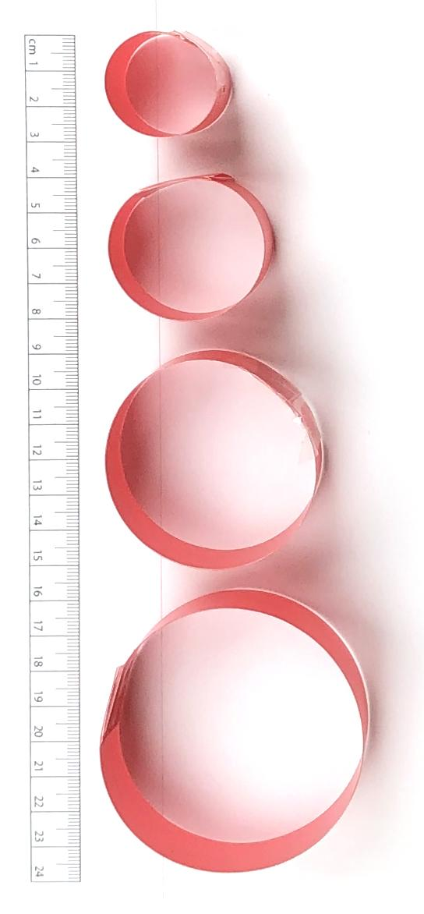
Slide J
Analyze Size Data and Update Progress Tracker
With a
Partner
Diameter of ring (cm) | Peak force in collision (N)
2.5 | 3.8
4 | 3.4
5.5 | 3.1
7 | 2.9
Analyze the data on this slide.
Add to your Progress Tracker under the entry for this question: How (and why) does the structure of a cushioning material affect the peak forces produced in a collision?
All results were collected from a single ring attached to the tip of a spring scale mounted to a cart launched from the same pull-back position on a spring-scale launcher to ensure constant amount of kinetic energy across each condition tested.
Notes:
Introduce size data. Show slide J. Give students the remaining time to discuss the data on this slide with a partner and to add to their Progress Tracker (while still talking with a partner) under the entry for this question:
How (and why) does the structure of a cushioning material affect the peak forces produced in a collision?

Slide 11
Slide K
Navigation
We have explored how changes in the smaller-scale structures that make up a cushioning material could affect peak forces in a collision. And we have used large rings to represent a commonly found structural element in our top performing materials. We have chained those together in a line, and we have looked at the effect of making such structures smaller.
Turn and Talk
Do you think other changes to the structure or shape of a cushioning material would affect how much it reduces peak forces in a collision? Why or why not?
Be prepared to share with the whole class.
Notes:
Make initial predictions about changes to the structure or shape of a cushioning material and the related effect on peak forces in collision. Show slide K. Emphasize that students should discuss this question with a partner now so that we can share what ideas partners came up with as a whole class next time:
Do you think other changes to the structure or shape of a cushioning material would affect how much it reduces peak forces in a collision? Why or why not?

Slide 12
Slide L
Navigation
We have explored how changes in the smaller-scale structures that make up a cushioning material could affect peak forces in a collision. And we have used large rings to represent a commonly found structural element in our top performing materials. We have chained those together in a row, and we have looked at the effect of making such structures smaller.
As a Class
Did you and your partner think that other changes to the structure or shape of a cushioning material would affect how much it reduces peak forces in a collision? Why or why not?
Notes:
Share predictions from the end of last class. Show slide L. Discuss this question as a whole class, getting a few different reasons for the predictions that students made. Accept all responses.
Did you and your partner think that other changes to the structure or shape of a cushioning material would affect how much it reduces peak forces in a collision? Why or why not?
Say, Since we have some different predictions about the impact that other shape changes in a cushioning material will make in a collision, let’s collect some additional data on this question. Let’s test five different structures where we again use rings as a repeating substructure across each structure we test. These are the structures we are going to test.
Show students the 5 structures we will be testing. Ask students to describe the relative size and arrangement of the rings in each structure. Students will say that they are the same size and many are taped together.
Motivate testing a control. Say, For each of these structures let’s place them between a plate and the table and apply the same amount of force on the system and see how each structure will respond. Before we test all of these structures, let’s take some initial observations for one of the structures to serve as a control condition and then use this to make some predictions about how the rest of the structures will function in comparison to that.
Demonstrate the single-ring condition by placing one of the weighted electrical plates on it. Use the sticky putty on the back side of the plate to secure the ring to the bottom of it. Now, on the table, balance the weighted plate on top of the ring. Describe how you are trying to balance the plate on the ring without pushing down or lifting up more on the system to do so. Ask students to describe what they notice happening. They will say the ring deformed.
Remove the weighted plate. Say, I massed each plate before class and adjusted the amount of putty on each so that they all have the same weight. We can therefore use these to apply the same amount of force to these four other structures. Optional: Demonstrate this for a couple of plates by placing them on a digital scale, if needed.

Slide 13
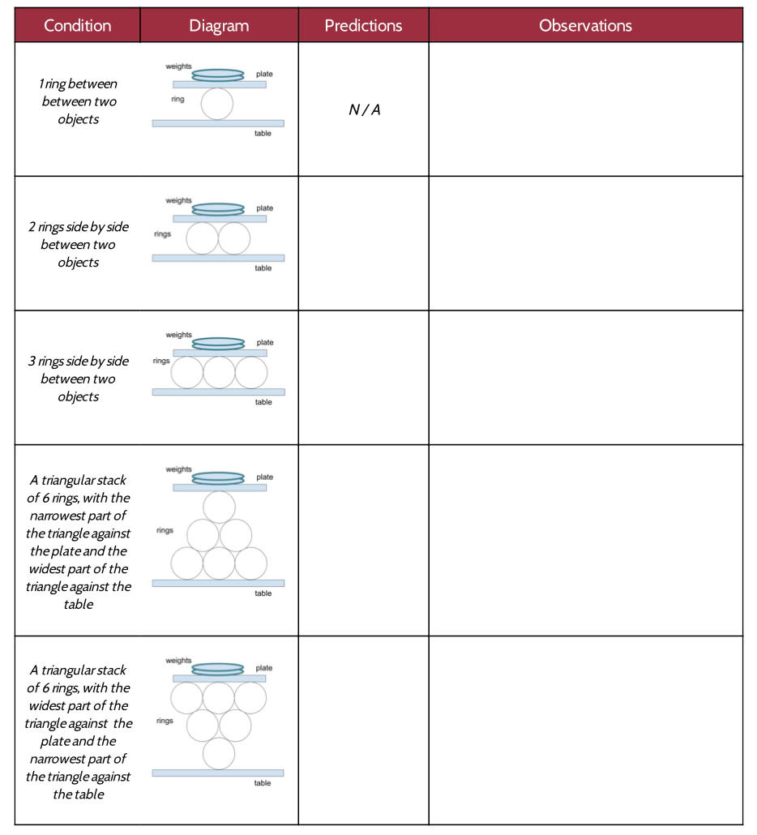
Slide M
Predictions
We’ve explored how changes in the smaller scale structures that make up a cushioning material could affect peak forces in a collision. And we’ve used large rings to represent a commonly found structural element in our top performing materials. We’ve chained those together in a line and we’ve look at the effect of making such structures smaller.
On Your Own
Add this handout to your notebook.
Record your predictions for how each structure will respond.
As A Class
Did you and your partner think that other changes to the structure or shape of a cushioning material would affect how much it reduces peak forces in collision? Why?
Notes:
Distribute Exploring shape of a cushioning material. Ask students to think about how the other structures will compare when we apply the same amount of weight on top of the plate but change the number of rings in between the plate and the table and record their predictions on the new handout you are giving them. Show slide M. Give students a couple of minutes to record their predictions on the handout.
Gather around a demonstration area. Have 3 students help balance the weighted plate on top of the first three structures (1 ring, 2 rings side by side horizontally oriented, and 3 rings side by side horizontally oriented) . Ask for student volunteers to help do this. Have the rest of the class gather around the demonstration area. Students volunteers should balance their weight on top of these structures, keeping it from tipping over but trying not to lift or push down on it any, just like you demonstrated. After doing this long enough for other students to record their observations (e.g., 2 minutes), ask another set of 3 volunteers to swap places with the first 3 students so that they can record observations as well.
Discuss the patterns they noticed as a class. Example prompts and responses can be found in the teacher guide.
Say, Let’s use our push-pull spring scales to test this. Let’s swap in a spring scale for a ring, since we know that the rings and the springs are both behaving elastically, and see how much force is registered on each spring scale. Ask for a student volunteer to record the results on the board for each condition tested (using 1 spring scale to support the weight, using 2 spring scale sto support the weight, using 3 spring scale to support the weight).
Ask for student volunteers to help hold and test the first condition. It will take at least two people to balance a weighted plate on top of a push-pull spring scale held upright. A third person can read the amount of force registered on the scale.
Do this again for two spring scales held upright under the weighted plate. This may take another person to do.
Do this again for three spring scales held upright under the weighted plate. This may take another person to do.
Give a minute for students to record their observations on their handout. Discuss student observations as a class.
Say, Let’s see if that actually affects the amount of damage on an object placed below it.
Place a sheet of Styrofoam on the table and under a spring scale with the plunger touching the Styrofoam. Stack three of the weighted plates on top of the spring scale. This will make an indentation on the Styrofoam. With a fine-tip permanent marker trace the outline of where the spring-scale plunger touches the Styrofoam before removing it.
Move to an undamaged spot on the Styrofoam. Hold three spring scales together with their plungers touching the Styrofoam and place the stack of three weighted plates on top of them so all three scales are holding up the stack of plates. Trace the outline of where all three spring-scale plungers touch the Styrofoam before removing them.
Hold up or pass around the Styrofoam and ask students to describe what they notice. Students will say that there is more damage from the single spring scale than from the three.
Say, This three-spring-scale structure provides more points of contact to push back. Because of that, the amount of contact force at each point of contact is less. In a way, we can think of the structure as spreading out the force it is pushing back with across a larger surface area. And from the Styrofoam we can see that this has an effect on the damage on a material it is in contact with. So we can see that it's not just how much peak force is applied to a material that causes it to be damaged. It’s really how much peak force is being applied at a particular spot on the material. So if you can spread the amount of force being applied to more spots or over a greater area, this should result in less damage to the object those forces are being applied to. Let’s see if we can use these ideas to explain what our six-ring, triangular structures do when a force is applied to them.
Carry out the last two structure tests in the demonstration area. Prepare to test the last two structures (6- ring, triangular shape). Ask for student volunteers to help do this. Student volunteers should balance their weight on top of the last two structures (6-ring, triangular shape). Ask for student volunteers to help do this. . Student volunteers should balance their weight on top of the structures, keeping it from tipping over but trying not to lift or push down on it any, just like you demonstrated. After doing this for a minute as other students record their observations, ask for 2 other volunteers to swap places with the first volunteers so that they can record observations as well.
Briefly discuss what students notice.

Slide 14
Slide N
Develop a Classroom Consensus Model
Progress Tracker
As a Class
Question
Sources of evidence
Prepare a new 3 section in your Progress Tracker.
Meet in a Scientists Circle to summarize what you figured out as a class for your lesson question across all your investigations.
What we figured out
Notes:
Say, Let’s summarize all of these discoveries in a Progress Tracker update as a class. Show slide N. Have students prepare a 3 column entry in their Progress Tracker. You will fill in this entry together as a class.
Gather students in a Scientists Circle. Hang a piece of chart paper. Layout a table for a whole class progress tracker entry as shown on slide N. Remind students that we’ve been working as a class on the same question about structure as the one they wrote in their Progress Tracker last time. Ask them to look back to see what that question was. Write it on the chart paper in the “Question” box and have students add it to their ”Question” section for this new Progress Tracker entry.
Then ask students, In the last lesson, what sort of testing and inspecting did we do with different cushioning materials before we started working with rings and what did we figured out from those. Students will say in the last lesson we did a series of collision investigations to determine which reduced forces the most and inspected those materials up close.
Ask students how we figured out that the top cushioners had similar structures in terms of a lot of empty space or air within their materials to deform into. Students will say we looked at up-close and microscopic photographs of cutaways of the materials.
Add to the Progress Tracker chart paper so that it reflects these ideas. Students should add similar information to their Progress Tracker entry. An example entry can be found in the teacher guide.
Ask students why we started to use rings to explore the behavior of these structures further and what we figured out at first from our increasing the space in a cushioning material through the ring collision videos. Example prompts and responses can be found in the teacher guide.
Emphasize that we also discovered that simply packing smaller and smaller spaces (or smaller rings) into a material and/or making the structure of that material more dense doesn’t necessarily help it reduce peak forces, and it actually may have the opposite effect.
Add to the Progress Tracker on the chart paper so that it reflects these ideas. Students should add similar information to their Progress Tracker entry. It should now have something like the entry found in the teacher guide.
Ask students to summarize what we figured out from the most recent test we did of 5 different ring structures. Listen for ideas like these:
The more you can spread the peak forces out over a larger area or over more points of contact, the less force is applied to each point of contact.
This can reduce the amount of damage on the material you are trying to protect.
Add these ideas to the Progress Tracker on the chart paper. Students should add similar information to their Progress Tracker entry. It should now have something like the third example located in the teacher guide.

Slide 15
Slide O
Preparing to Apply These Ideas to Your Design
Turn and Talk
How could these ideas be applied to the design of a protective headgear for preventing concussions in sports-related collisions?
How might you apply what we figured out to your design problem?
Notes:
Connect to a prior sports-related phenomenon and the design problem students have been working on. Remind students that they have been considering their own design problem for a few lessons now and that earlier in the unit they had looked at how some sports have a risk of concussions due to head collisions. Ask students to consider how what we summarized what we have figured out could be applied to both of these contexts. Show slide O. Give students 3 minutes to discuss these questions with a partner.

Slide 16
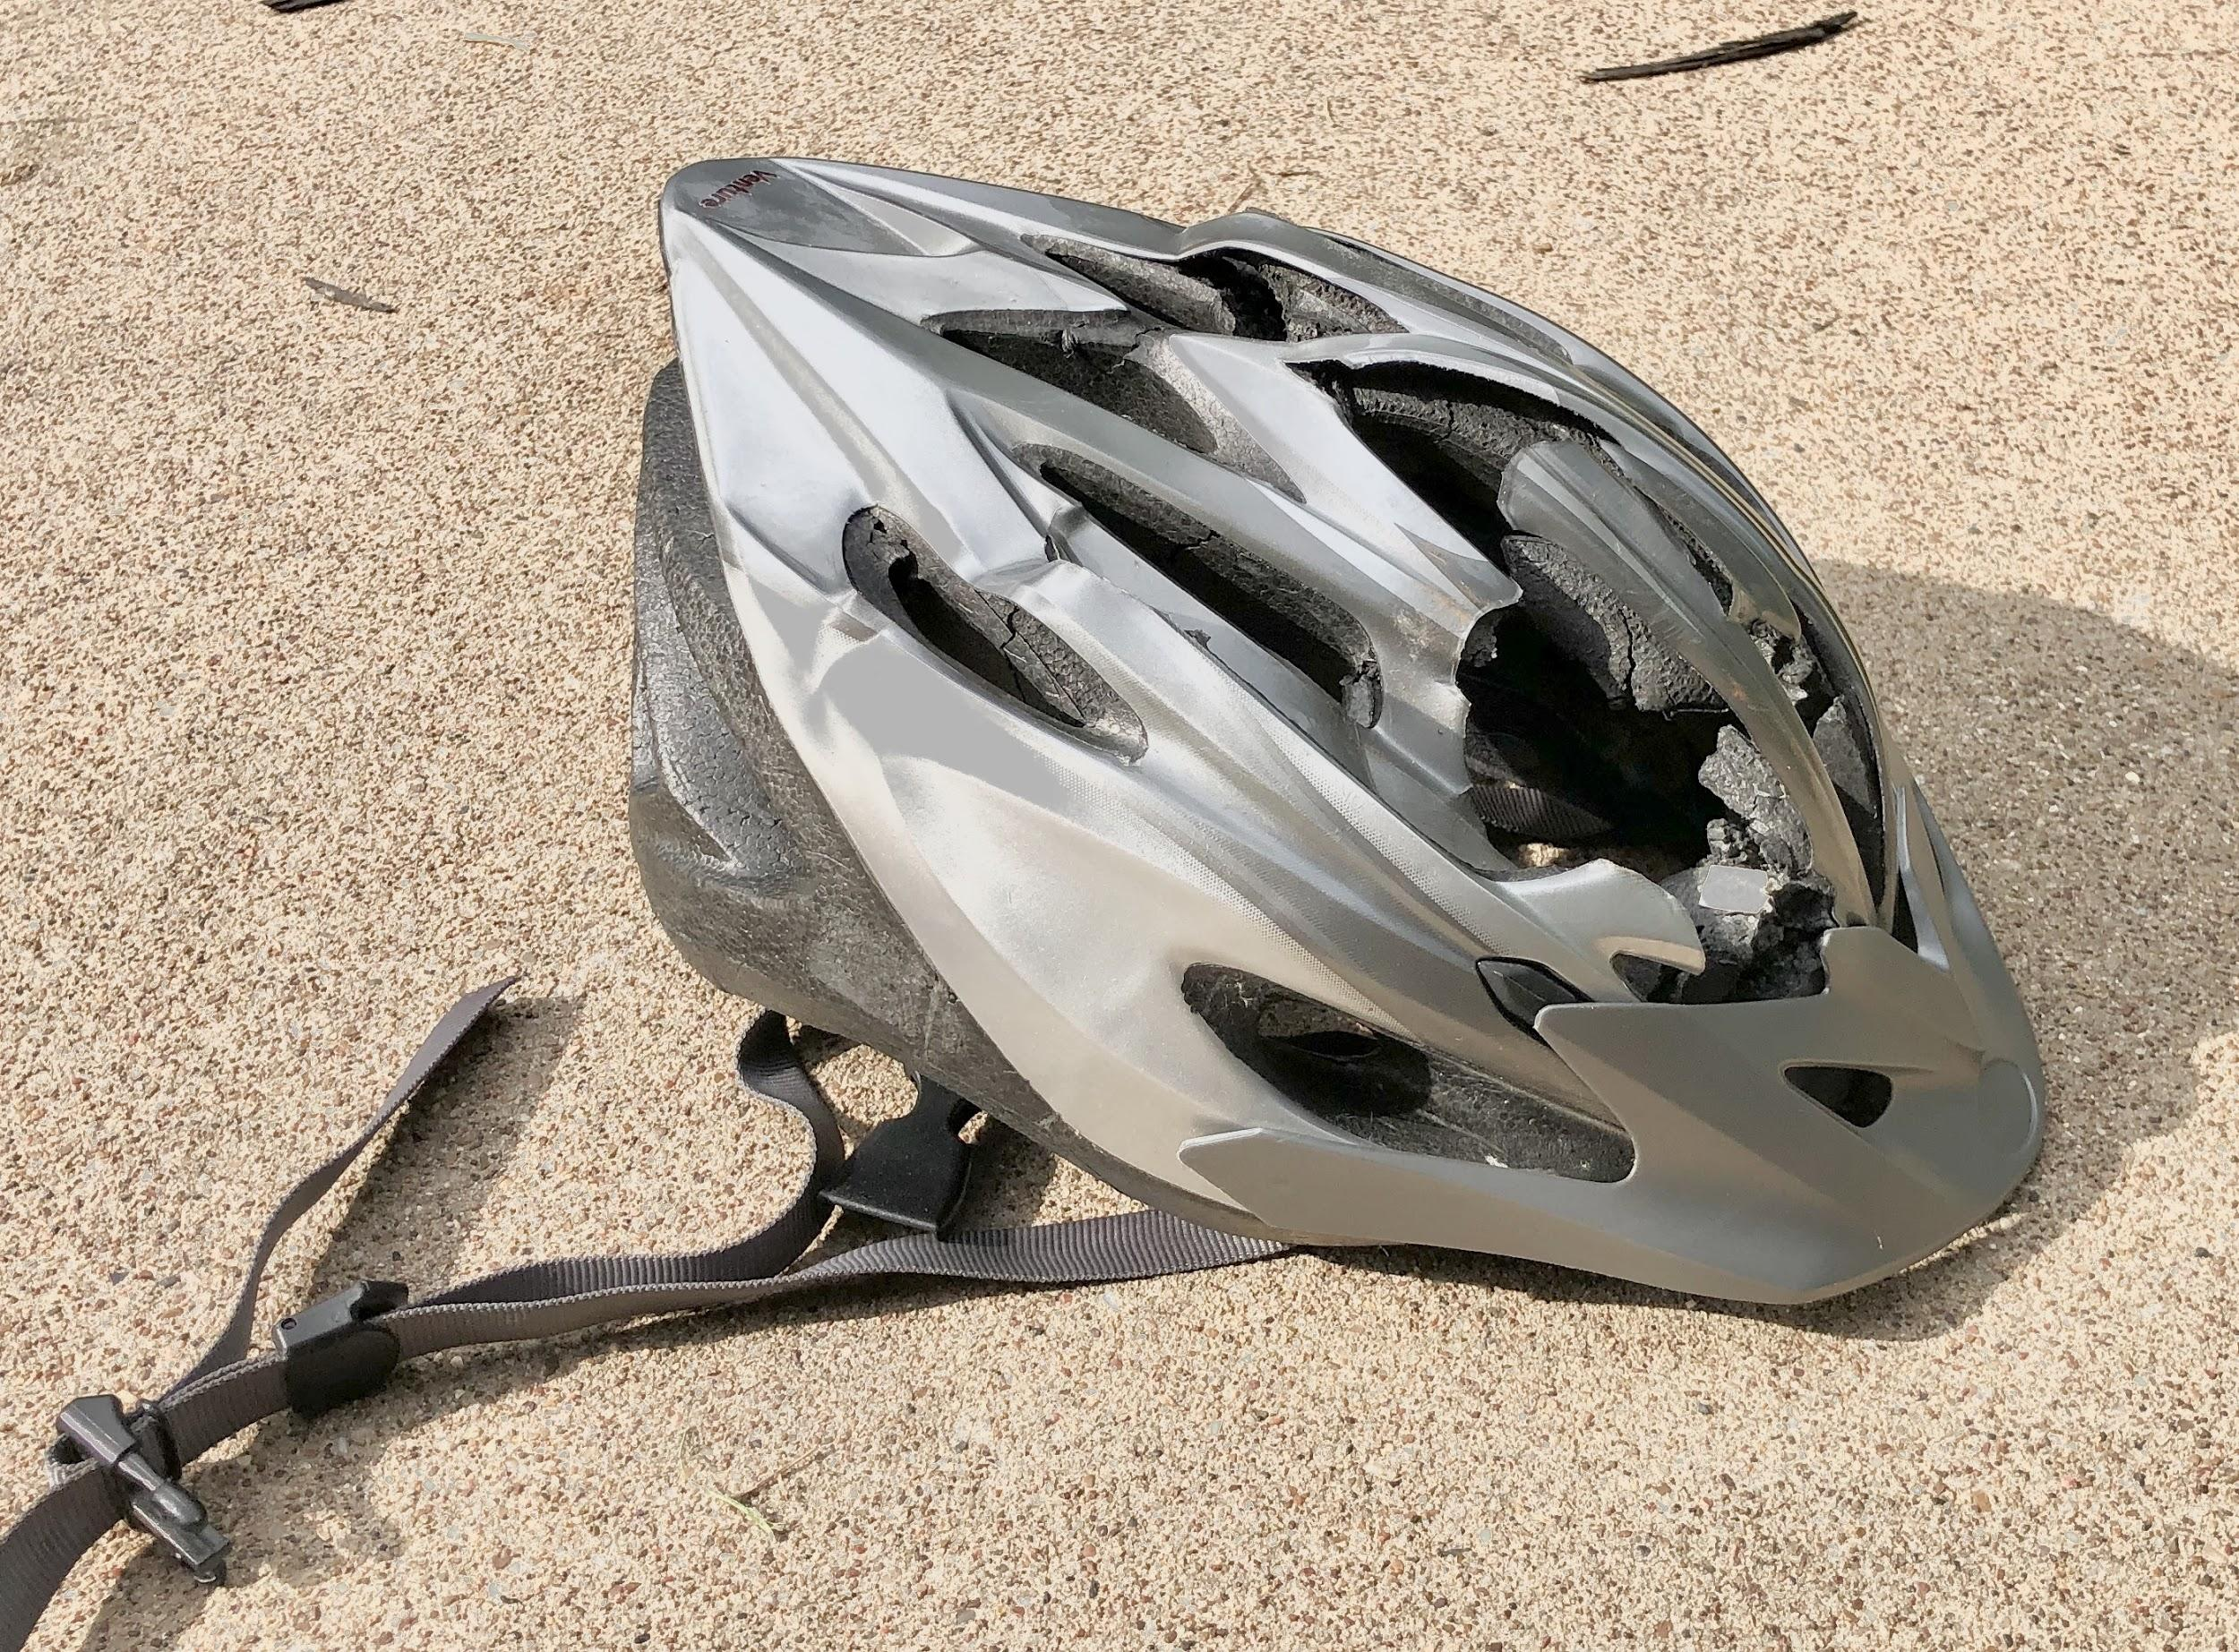

Slide P
Designing Protective Headgear
Your home learning will describe some way in which these ideas are applied to the design of a protective headgear for preventing concussions in biking-related collisions. You will use the ideas from this reading in an upcoming assessment.
Home Learning
Complete the questions in the reading and prepare to turn it in next time.
Notes:
Assign the home learning. Show slide P. Distribute Reading: Anatomy of a Bike Helmet. Emphasize that this reading will discuss the design of one type of protective headgear to prevent concussions related to collisions people can experience from riding a bike and that the information in the reading will include ideas that students will need to use on their assessment in a couple of days. Explain that assessment will come after they first revise their own designs and will involve evaluating protective headgear for preventing concussions in a different sport.

